Slide 1
Maintenance Grant and Fee Grant
SEE WWW.SUSI.IE

Slide 2
COVID 19 and your income
Grant looks at income from 1st Jan – 31st Dec.2019 but..
If you/your family have had a change in circumstances since 1st Jan 2020 – such as loss of employment or
Permanent salary reduction
Retirement
Having to cease trading ( Self Employed)
After application to Susi -email support@susi.ie with CHANGE OF CIRCUMSTANCES in the subjects line

Slide 3
ELIGIBLE FOR GRANT IF
ENROLLED IN AN I.T./UNIVERSITY FULLTIME COURSE
ENROLLED IN A FULLTIME COURSE IN A PLC
Subject to EU Residency Conditions and granting of Refugee Statue

Slide 4
PLCS
NO FEE GRANT FOR PLCS – MAINTENANCE ONLY
PLC FEES TYPICALLY AROUND 600 PER YEAR – WITH DISCOUNT FOR MEDICAL CARD HOLDERS – SEE THEIR WEBSITES FOR DETAILS

Slide 5
FEE GRANT
The fee grant is made up of three elements as follows:
Tuition Fee – paid by the state- unless you are non EU National/have not resided in the EU for 3 yrs prior to college entry.
Student Contribution Charge of E 3000 –if eligible for Grant SUSI pays this
Compulsory Field Trip Expenses; eg – UCC Geography Field Trip to the Burren.

Slide 6


Slide 7


MAINTENANCE GRANT
FOR YOUR DAY TO DAY EXPENSES
+45KM FROM YOUR HOUSE - GRANT
Notes:
AA ROUTEFINDER

Slide 8
ADJACENT/NON-ADJACENT RATES
IF YOUR RESIDENCE IS MORE THAN 45 KM AWAY FROM THE COLLEGE YOU GET THE HIGHER MAINTENANCE GRANT LEVEL
DISTANCE CALCULATED USING YOUR EIRCODE

Slide 9
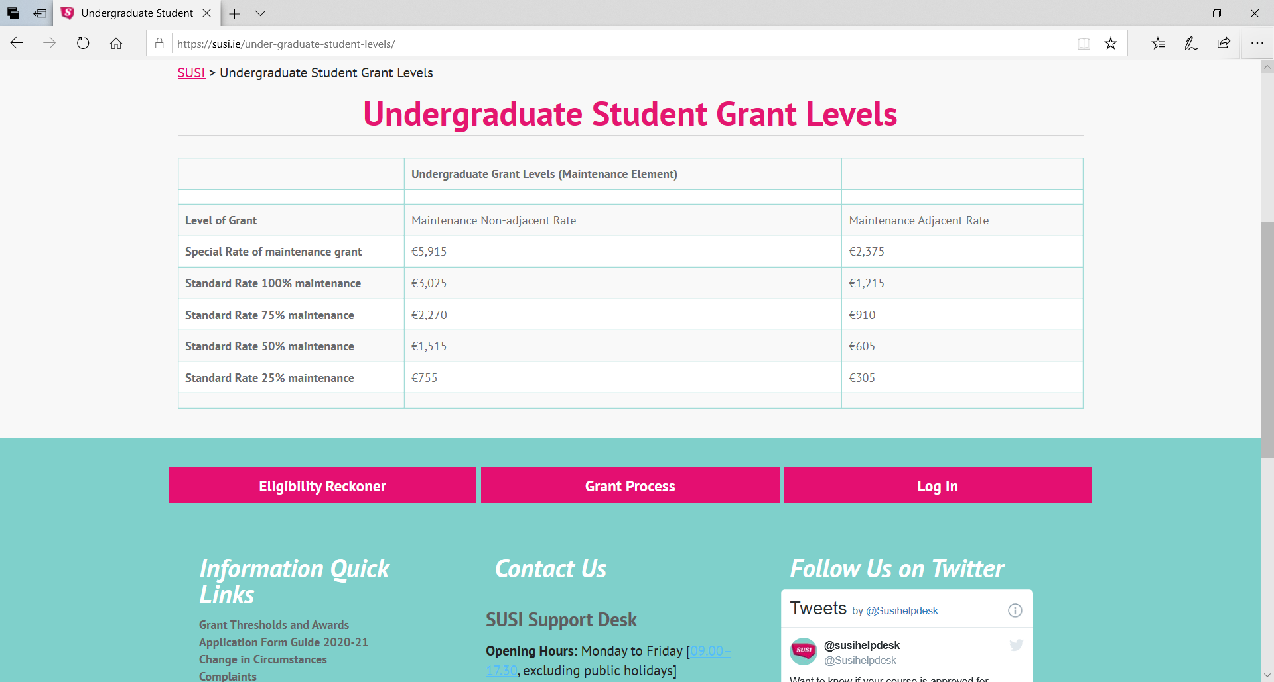
MAINTENANCE GRANT LEVELS

Slide 10
WHAT CLASS OF APPLICANT ARE YOU?
LIVING AT HOME WITH FAMILY
THEIR INCOME AND YOUR INCOME ASSESSED
TYPICALLY NOT LIVING WITH FAMILY
DIFFERENT ADDRESS
YOUR INCOME ASSESSED
DEPENDENT
INDEPENDENT

Slide 11
HOW IS GRANT CALCULATED?
GROSS FAMILY INCOME (INCLUDING student’s INCOME ) EARNED FROM 1ST JAN. TO DEC.31ST 2019
HOW MANY DEPENDENTS ARE AT HOME (PEOPLE IN FULL TIME EDUCATION OF ANY SORT)
CHILD BENEFIT ,LONE PARENTS ALLOWANCE NOT CALCULATED AS INCOME

Slide 12
INCOME NOT COUNTED FOR GRANT APPLICATION
Child Benefit,
Family Income Supplement,
Disability Allowance (where paid to the applicant),
Blind Pension (where paid to the applicant),
One Parent Family Payments (Means Tested) (where paid to the applicant),
Guardian’s Payment,
Foster Care Allowance,
Domiciliary Care Allowance,
Carer’s Allowance,
Student Assistance Fund,
Student Grant,
Compensation for a personal injury.
Carer's Support Grant (Respite Care grant) – when paid in conjunction with Carer’s Allowance or Domiciliary Care Allowance
Aftercare Allowance
Caranua Services Support
Department of Education and Skills Third Level Bursary Scheme,
Exceptional Needs Payment,
Household Benefits Package,
Housing Assistance Payment, to include Rental Accommodation Scheme (RAS)
Independent Living Allowance for Young People in Residential Care,
Jobseekers Allowance Transition (where paid to the applicant),
Mortgage Interest Supplement,
Rent Supplement,
Water Conservation Grant
Back to Work Family Dividend
DEASP Temporary Provisions Payment (Christmas Bonus Payment)
Mobility Allowance (where paid to the applicant)
Information is provided for guidance only and does not guarantee eligibility for a student grant award.

Slide 13
INCOME LEVELS
CHECK TO SEE WHAT GRANT YOU ARE ELIGIBLE FOR by pasting this url into your browser
https://susi.ie/undergraduate-income-threshold-and-grant-award-rates/
Remember to add on E4650 onto your income if a parent/child is in college. Apprenticeships don’t count.

Slide 14

SEMESTER/YEAR ABROAD
Compulsory period of study abroad/Period of study on Erasmus:
Students whose course of study includes a compulsory period of study abroad, and those who elect to take part in a period of study or work on Erasmus, will continue to receive their maintenance grant payments.

Slide 15
How to Apply
Apply at www.susi.ie – Opens on April 23rd
Meanwhile check the site's Eligibility Reckoner
Get your documentation together – P60 etc – search ‘ Document Requirements ‘ on SUSI website
Any queries ring Susi @ 076 108 7874 or contact them at support@susi.ie

Slide 16
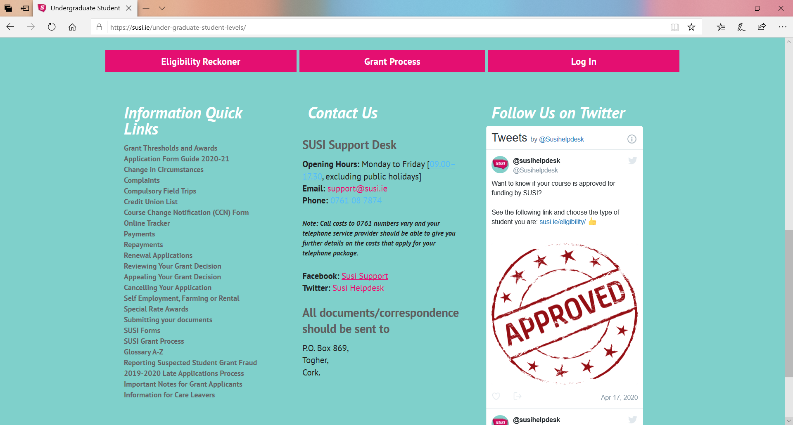
CONTACT SUSI

